Slide 1

2017 Citi Bike Operations Report |
Data Scientist: Xinran Pan

Slide 2
1.
Understanding & Preprocessing Ridership Data
2.
Ridership
Data Visualization
3.
Kiosk Feature:
Travel Time
Prediction

Slide 3
1.
Understanding & Preprocessing Ridership Data
2.
Ridership
Data Visualization
3.
Kiosk Feature:
Travel Time
Prediction

Slide 4
NYC Citi Bike Data
 | Original Citi Bike Dataset | Preprocessing Procedure | Cleaned and Preprocessed Dataset
Data Points: | 16.4 Million |  | 1 Million
No. of Features: | 15 |  | 21
Features Type: | Trip Duration Start Time and Date Stop Time and Date Start Station Name End Station Name Station ID Station Lat/Long Bike ID User Type Gender Year of Birth | Aggregate Jan-Dec 17 csv files Drop rows with - duplicates - null values - an unknown gender - same start and end stations - trip durations > 75 min - trip distances > 40 miles - trip rates > 30 mph Randomly sample 1 million rows Added new features including - Trip Rate - Age - Age Groups Dropped Year of Birth | Trip Duration Start Time and Date Stop Time and Date Start Station Name End Station Name Station ID Station Lat/Long Bike ID User Type Gender Trip Duration (min) Trip Rate Age Age Groups Start/Stop Time Date
Data Source: Citi Bike System Data

Slide 5
1.
Understanding & Preprocessing Ridership Data
2.
Ridership
Data Visualization
3.
Kiosk Feature:
Travel Time
Prediction

Slide 6
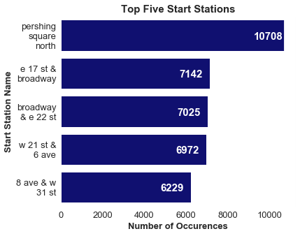
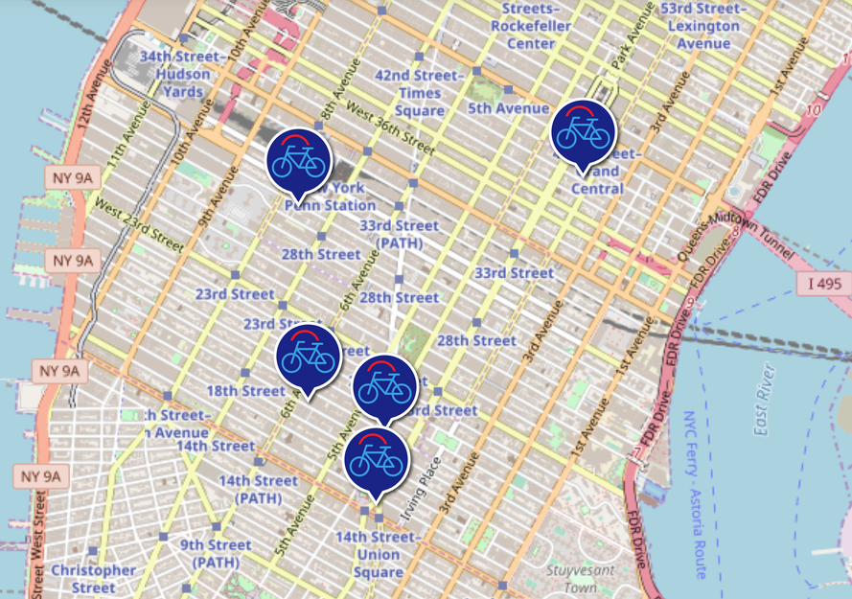
Top Five Start Stations

Slide 7
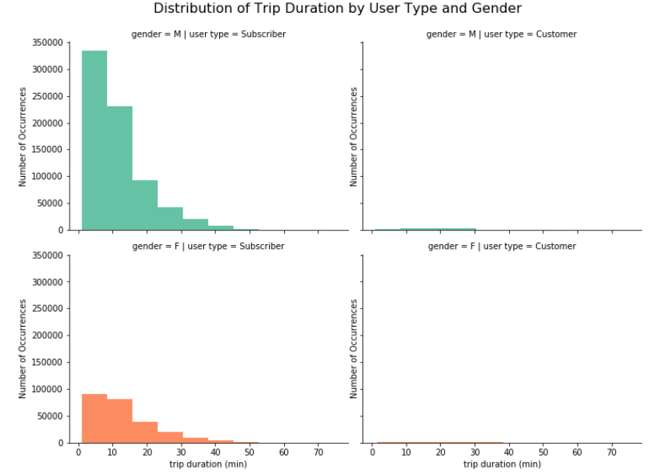
Trip Duration by User Types

Slide 8
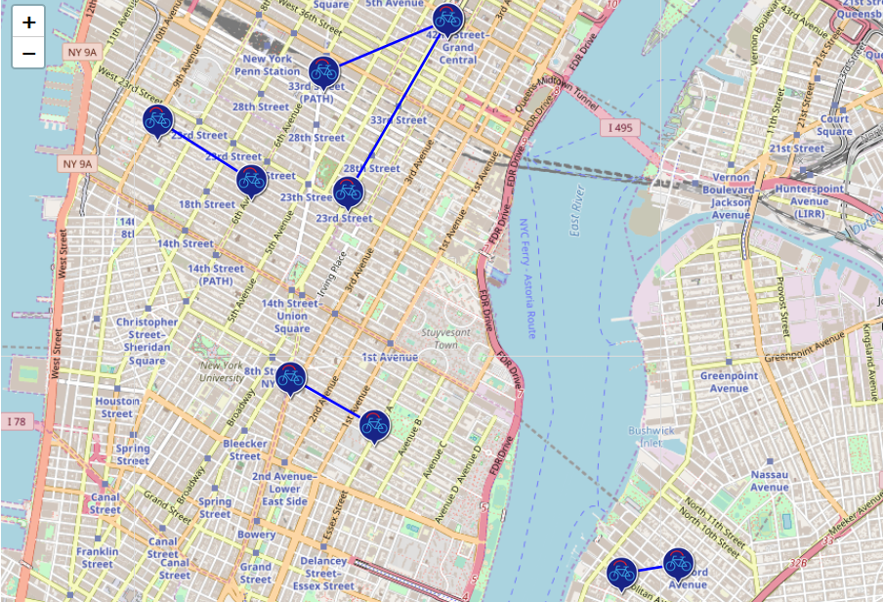
Most Popular Trips Based on Start/Stop Stations
Top | Start Station | End Station | No. of Trips
1 | E 7 St & Avenue A | Cooper Square & E 7 St | 414
2 | W 21 St & 6 Ave | 9 Ave & W 22 St | 357
3 | N 6 St & Bedford Ave | Wythe Ave & Metropolitan Ave | 300
4 | Pershing Square North | E 24 st & Park Ave S | 300
5 | Pershing Square North | Broadway & W 32 St | 295

Slide 9
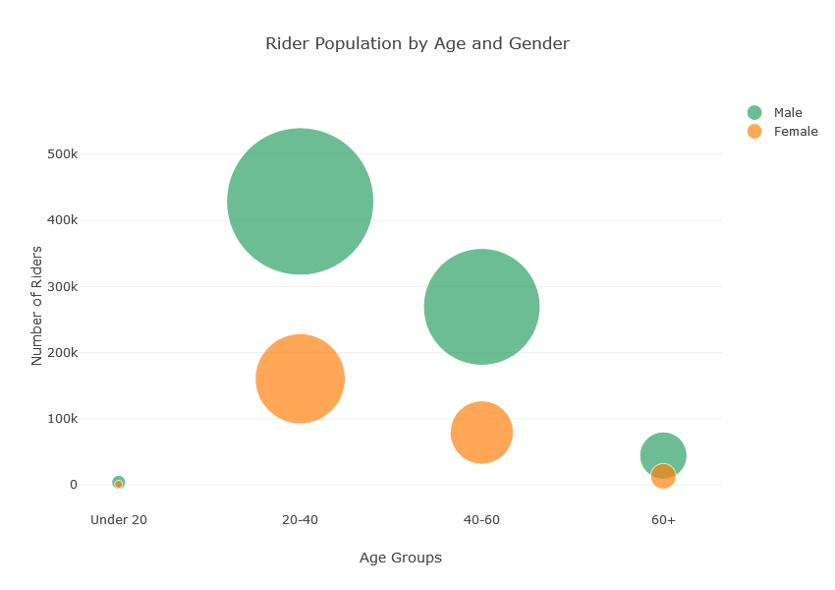
Rider Population by Gender and Age

Slide 10
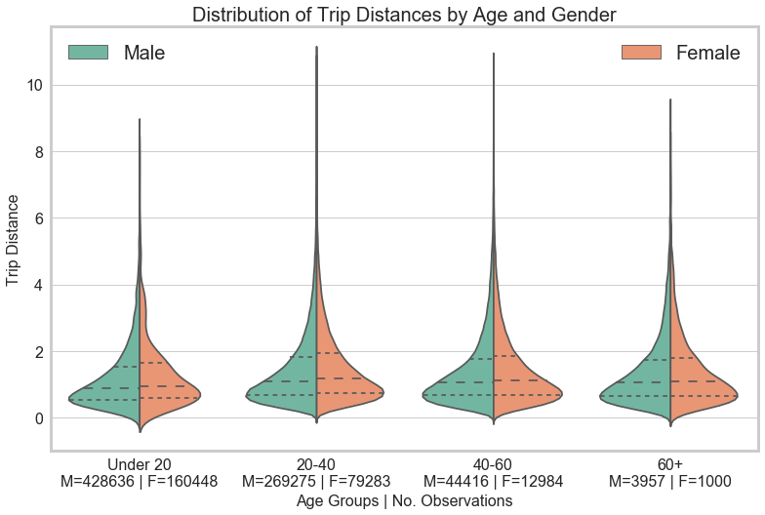
Average Trip Distance by Gender and Age

Slide 11
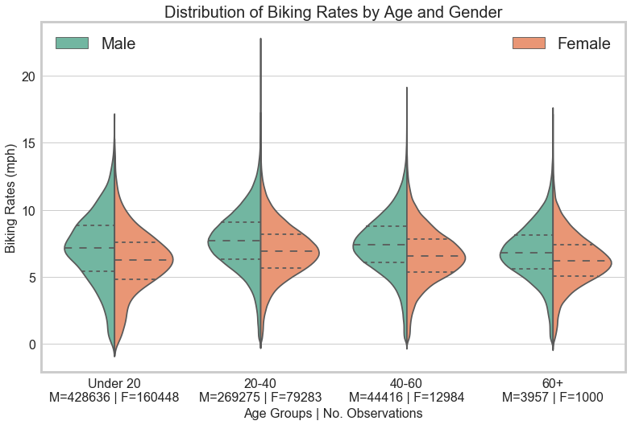
Average Biking Rate by Gender and Age

Slide 12
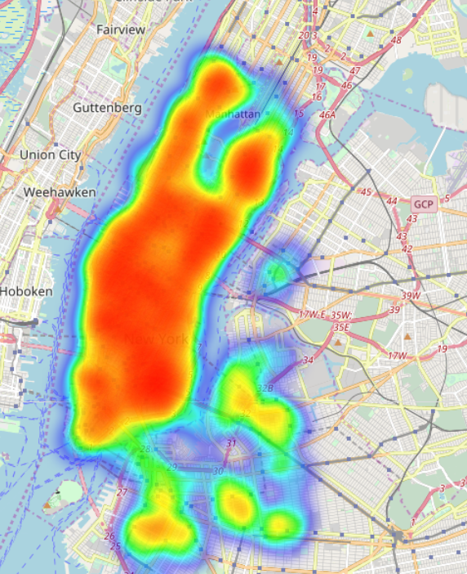



Busiest Bike In 2017
Heatmap of Trips of NYC’s Busiest Bike
Bike ID:
26042
Total No. of Minutes Used:
2053
No. of Times Used:
166

Slide 13
1.
Understanding & Preprocessing Ridership Data
2.
Ridership
Data Visualization
3.
Kiosk Feature:
Estimate Travel Time

Slide 14
NYC Weather Data
 | Original Weather Dataset | Preprocessing Procedure | Cleaned and Preprocessed Dataset
Data Points: | 365 |  | 365
No. of Features: | 12 |  | 7
Features Type: | Station Name Latitude Longitute Elevation Weather date Avg Wind Speed Precipitation Snowfall Snow Depth Min Temp Max Temp | Obtain from ncdc.noaa.gov Preprocessed using Excel Dropped features - duplicates - null values - Station - Name - Latitude - Longitute - Elevation Selected weather data from the Central Park station only | Weather date Avg Wind Speed Precipitation Snowfall Snow Depth Min Temp Max Temp
Data Source: https://www.ncdc.noaa.gov/cdo-web/datasets

Slide 15
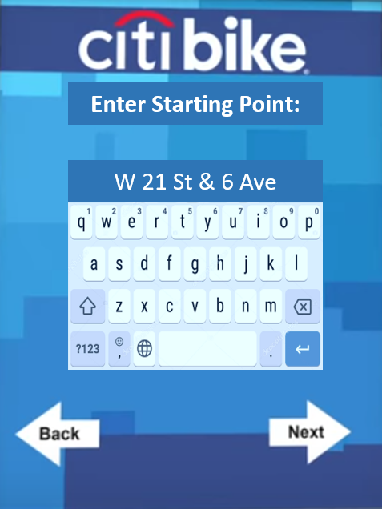

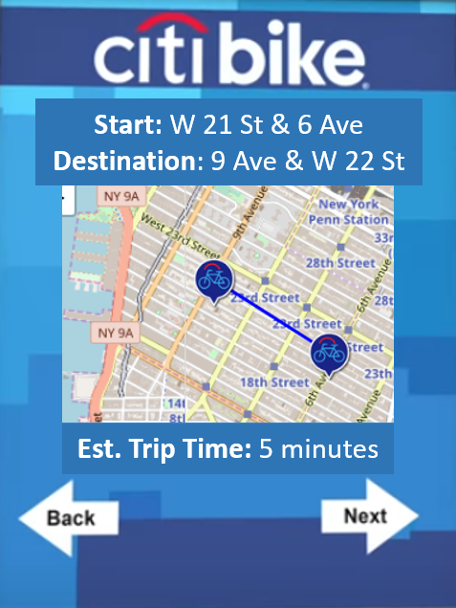
New Kiosk Feature: Estimate Travel Time
Step 1:
Step 2:
Step 3:

Slide 16
Modeling: Time Travel Prediction
 | Type of Model | Good Predictor | Evaluation Error
Model 1 | Linear Regression | No
Model 2 | XGBoost | Yes | RMSLE: 1.17899
Start | Destination | Trip Distance (Miles) | Predicted Trip Time (Minutes)
PERSHING SQUARE NORTH | E 24 ST & PARK AVE S | 1.06 | 3.52
N 6 ST & BEDFORD AVE | WYTHE AVE & METROPOLITAN AVE | 0.48 | 2.58
W 21 ST & 6 AVE | 9 AVE & W 22 ST | 0.21 | 2.67

